Slide 1
Linear Relations
Unit 8

Slide 2
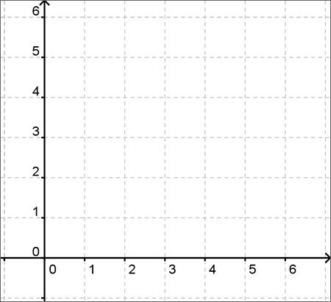
Graphing-Plotting Points
You have two axis when plotting points onto a graph. These axis correspond to a to coordinates you can plot onto the graph.
(x, y)
X-axis is the horizontal (flat) axis
Y-axis is the vertical (tall) axis

Slide 3
Plot This
(2,5)
(0,2)
(4,0)
(3,1)

Slide 4
Battleship
Rules
At the start of the game place 5 ships anywhere you would like on your side of the sheet. Ships can be placed Vertically or Horizontally.
Take turns firing against your partner trying to sink their ships. Say a letter and a number to choose one square. Ex. E5
Let your partner know if they hit a ship or missed.

Slide 5
Review
Draw a graph and label the x and y axis.
Plot (4,8)
Plot (2,4)
Plot (0,2)
What do you notice about these points?
Grab a Whiteboard

Slide 6
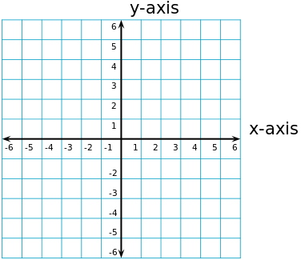
Cartesian Plane
Is defined by two perpendicular number lines: the -axis, which is horizontal, and the -axis, which is vertical.
Using these axes, we can describe any point in the plane using an ordered pair of numbers.

Slide 7
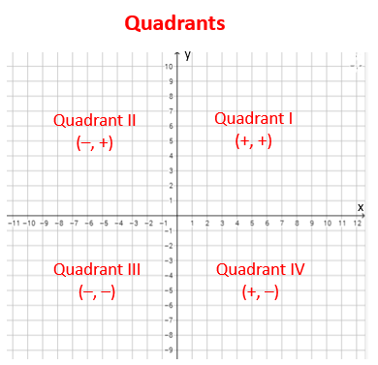
Quadrants
When plotting points is important to look at to correct place to plot them.
Where would you plot (-2,5)?

Slide 8
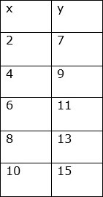
Graphing Tables
Tables are used to represent relationships between numbers.
A table of values will show a linear (straight line) relationship between the numbers. This allows for infinite possibilities that will land on a particular line.

Slide 9
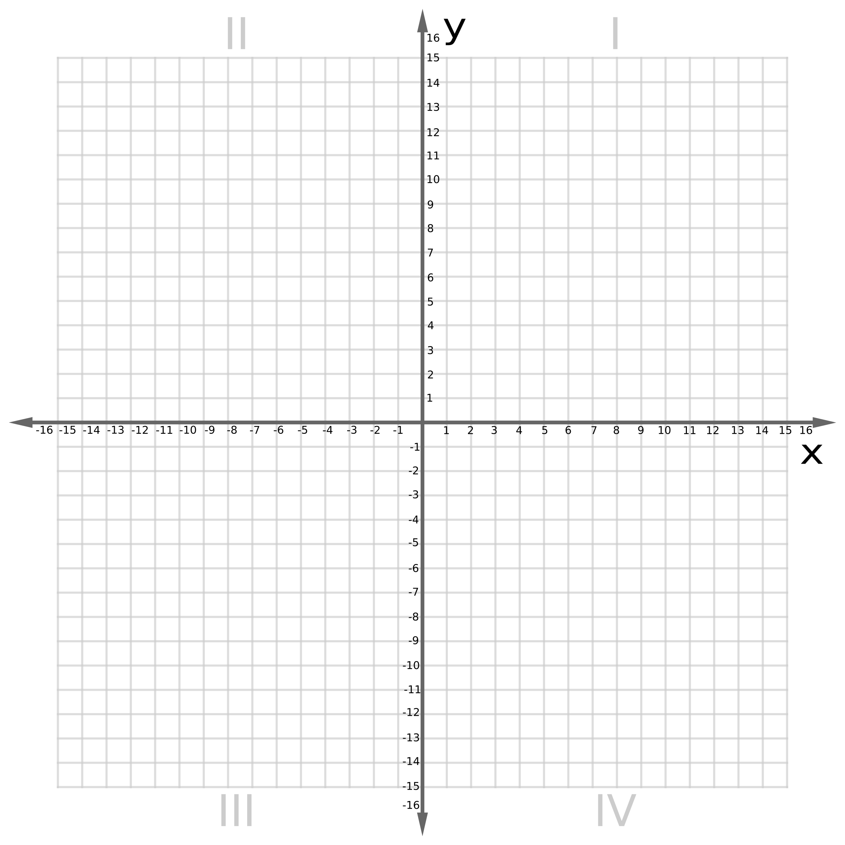
Plot the tables
Plot the tables in different colours.
What is similar between them?
What is different between them?

Slide 10
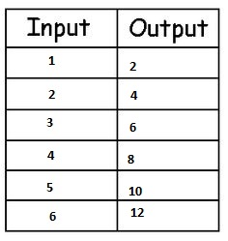
Graph

Slide 11
Creating Tables of Values
https://www.youtube.com/watch?v=52tpYl2tTqk

Slide 12
Review
What quadrant would (4,-3) be placed?

Slide 13
Solving Equations
When solving for a variable, it is important to isolate the variable. That means get it by itself. To do this we must complete the inverse functions.
Inverse=Opposite
Ex. The inverse of addition (+) is subtraction (-)
Ex. w - 4 = 10
w - 4 + 4 = 10 + 4
w = 14

Slide 14
1 Step Equations
You only need to complete one step to determine what the variable is. They can be shown 4 different ways:
x+4=10 x-4=10
2x=10 x÷2=10 or x/2=10

Slide 15
Solve
w-3=15
d+5=-3
-3x=33
x÷2= -5

Slide 16
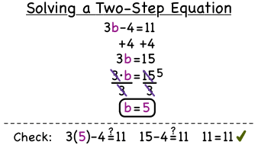
2 Step Equations
You will need to complete two inverse functions to isolate the variable. You will need to add/subtract first, then finish the question with dividing/multiplying.
Think of BEDMAS but backwards…
*SADM*

Slide 17
Solve
4r-2 = 14
s + 3 = 5
-4
8x - 7 = -31
p -1 = 18
2

Slide 18
Practice
-10 = 4n - 12 7w - 9 = 12

Slide 19
Practice
6+ n = 14 f + 3 = -2
9 -5

Slide 20
Cali borrowed $19 from her brother. The next day, she paid back $3. To pay off the rest of the debt, she will give him $4/week. How many weeks will it take her to pay off the debt?

Slide 21
You are buying lunch at Sandwich Express. The cost is $4 for a sandwich and $2 each for your choice of extras. You have $10. The equation to determine how many extras you can get is 10 = 2e + 4, where e is the number of extras. How many extras can you buy if you spend all of your money?

Slide 22
If Jennifer doubled the money that she has in her account now and then took out $50, she would have enough left in her account to buy a new bike that costs $299. How much money did Jennifer start with?

Slide 23
In Canada, the percent of high school students who say their favourite subject is science is 1% less than one half
of the number of students who choose math. The percent of students who prefer science is 6%. What percentage prefer math?

Slide 24
The elevation of Qamani’tuaq, Nunavut, is 1 m less than one half the elevation of Prince Rupert, British Columbia. If the elevation of Qamani’tuaq is 18 m, what is the elevation of Prince Rupert?

Slide 25
The mass of a Persian cat is typically 2 kg less than one third
of the average mass of a border collie. The average mass of a
Persian cat is 4 kg. Describe how you might determine the average mass of a border collie?

Slide 26
Review
What acronym can you follow for solving equations?
What does the word inverse mean?
Solve for x:
3x+5=26

Slide 27
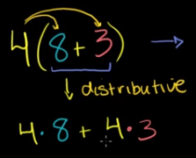
Distributive Property

Slide 28
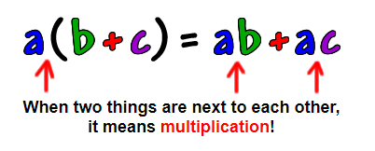
*Remember*

Slide 29
Distributive Property
The distributive property lets you multiply a sum by multiplying each added separately and then add the products.

Slide 31
Solve
5(3+5)= b) 2(8+5)=

Slide 32
Solve
c) 4(10-3)= d) 6(3-5)=

Slide 33
Solve for the variable - Distributive Property
3(t-2) = 12
*3(u - 12.5) = -3.41
b) 6(m+6) = -18
*2(x + 1.5) = 7.6

Slide 34
Solve for the variable - Distributive Property
c) -4(x-7) = 16
*2(x + 3) + 3(x + 2) = 0.5
d) 2(r+3) = -6
*4(d + 3) - 3(d - 2) = 1.2

Slide 35
Method 2: Divide First
*Remember*
When solving for a variable, complete the inverse (opposite) functions.
Start with dividing!

Slide 36
Solve for the Variable-Divide First
6(f+13) = 36
*6.2(2g - 3) = 4.2(2g + 3)
b) -5(x-1) = 25
*15.3 - 8.9 - 1.3a = 4.3a + 0.1

Slide 37
Solve for the Variable-Divide First
c) -21 = 3(k+3)
d) 8(x-7) = -32

Slide 38
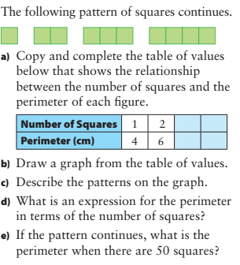
Word Problem

Slide 39
Word Problems
The fence around Gisel’s new tree is in the shape of an equilateral triangle. Gisel wants to increase the length of each side by 7 cm. The perimeter of her new fence will be 183 cm. Determine the length of each side of the old fence.

Slide 40
Word Problems
The amount of food energy per day required by hikers is modelled by the equation:
e = -125(t - 122)
Where e is the amount of food energy, in kilojoules (kJ), and t is the outside temperature, in degrees Celsius.
If the outside temperature is -20 °C, how much food energy is required per day?

Slide 41
Word Problems
Barney wants to frame a square picture of his dog. The frame he bought fits a picture with a perimeter no greater than 96 cm. He plans to put a 2-cm blue border around the picture. What are the maximum dimensions that the picture can have.

