Slide 1
Number Relations
Chapter 1

Slide 2
Squares!
Grab a whiteboard, marker and an eraser.
On the whiteboard describe what a square is….
What do squares look like?
How are squares related to math?

Slide 3
Square Scavenger Hunt
Find the Squares!
Objective: Go around the room and find as many squares as you can.
Draw/Trace them onto a sheet of paper.
*Find at least 5 Squares

Slide 4
How do you know you found squares?
What are the characteristics to describe a square?

Slide 5
Review
What is the formula for the area of a rectangle or square?
What units do we measure area in?

Slide 6
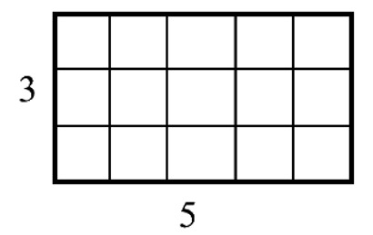
Area
Area is the amount of space a 2D object take up. The area of a square or rectangle can be found using one one the formulas below.
A=Base x Height
Or
A=Length x Width

Slide 7
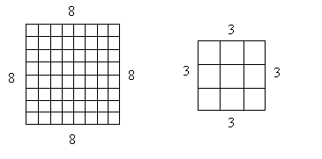
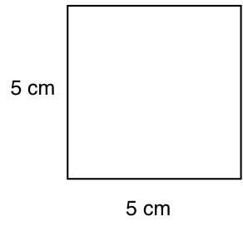
Find the area of the following shapes

Slide 8
Composite shapes
9 m
4 m
Shapes that include two or more smaller shapes.
Calculate the area of each space then add them together.
The sum is the total area of the space.
4 m
15 m

Slide 9
Calculate the area of this composite shape
5’’
3”
3”
10”
7”
1”

Slide 10
Find the side length of the following shapes
b)
A=16m²
A=16m²
8m
4m

Slide 11
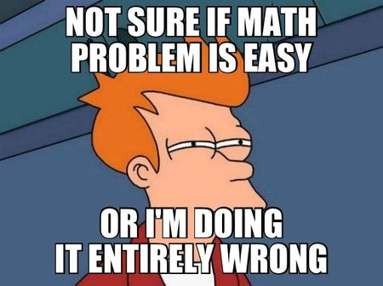
What do you notice about the sides of this square?
A=16m²
4m

Slide 12
Squares
Squares are special shapes because both side lengths are the exact same. This means when finding the area of a square we only need to know the length of one side.
Additionally, when finding the area of a square we only need to find one number that when multiplied by itself is equal to the area we are trying to find.
This is where the term square number comes from

Slide 13
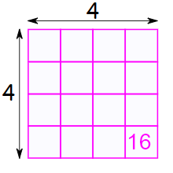
What is a Square Number?
The number we get after multiplying an integer (not a fraction) by itself.
4 x 4 = 16
16 is a square number

Slide 14
Review
What is the formula for area of a rectangle or square?
What is so special about a square?
What is a square number

Slide 15
Discovering Squares
With a partner grab one sheet of paper and one pencil
With the manipulatives you are given, create as many squares as possible
Write down the area of the squares you create as well as the side length of each.

Slide 16
What did you find?

Slide 17
First Ten Square Numbers
1² = 1
2² = 4
3² = 9
4² = 16
5² = 25
6² = 36
7² = 49
8² = 64
9² = 81
10² = 100
The first ten square numbers are;
1, 4, 9, 16, 25, 36, 49, 64, 81 and 100
These square numbers are created by the integers;
1, 2, 3, 4, 5, 6, 7, 8, 9, and 10
*Benchmark Numbers

Slide 18
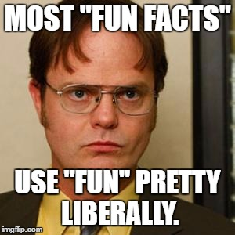
Fun Fact!
Perfect square numbers only end in 0,1,4,5,6 or 9. If a number does not end in one of these digits it is not a perfect square.
However, just because a number ends in 0,1,4,5,6 or 9 does not mean it is a perfect square.

Slide 19
Which numbers are perfect squares?
100
72
64
81
e) 74
f) 101
g) 1
h) 42

Slide 20
Find the Solutions to each
11²
12²
14²
21²
32²
f) 45²
g) 58²
h) 8.6²
i) 20.42²
j) 45.2²

Slide 21
Review
What is a square number?
What makes that number a square?
Can you square any number?

Slide 22
Identifying Perfect Squares
There are two methods we will use to identify if a number is a perfect square;
Identify using the square root
Prime factorization

Slide 23
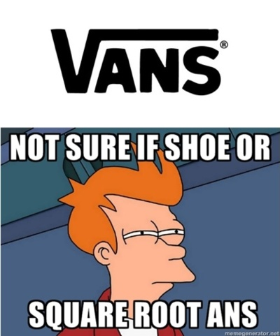
Square Roots
The square root of a number is a value that, when multiplied by itself, gives the number.
Example: 4 × 4 = 16, so a square root of 16 is 4.
Note that (−4) × (−4) = 16 too, so −4 is also a square root of 16, but because we will be using the square roots for measurement we will disregard the negative answers.

Slide 24
What is the Square Root of each number?
100
121
56
62
e) 64
f) 25
g) 37
h) 400

Slide 25
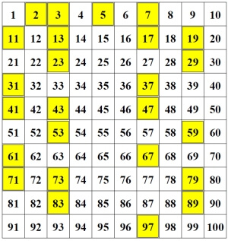
Prime Numbers
A prime number is a whole number that can not be made by multiplying other whole numbers. The only factors of a prime number are 1 and itself.
For example, 2 is a prime number because it's’ only factors are 1 and 2.

Slide 26
Prime Factorization
Prime factorization is finding the factors of a number that are all prime. Each of these prime numbers can be multiplied to create the original number. A number is considered square if it has an even amount of the same prime factor. To complete prime factorization;
Find two factors of your number.
Look at your two factors and determine if one or both of them is not prime.
If it is not a prime factor it.
Repeat this process until all your factors are prime.

Slide 27
Find the Prime Factorization of 24
Find two factors of your number.
Look at your two factors and determine if one or both of them is not prime.
If it is not a prime factor it.
Repeat this process until all your factors are prime.
24

Slide 28
Find the Prime Factorization of 81
Find two factors of your number.
Look at your two factors and determine if one or both of them is not prime.
If it is not a prime factor it.
Repeat this process until all your factors are prime.
81

Slide 29
Find the Prime Factorization of 36
Find two factors of your number.
Look at your two factors and determine if one or both of them is not prime.
If it is not a prime factor it.
Repeat this process until all your factors are prime.
36

Slide 30
Find the Prime Factorization of 400

Slide 31
Review
What are two ways to tell if a number is a perfect square?
How many answers does the square root of a number give?
c) What is the prime factorization of 42?

Slide 32
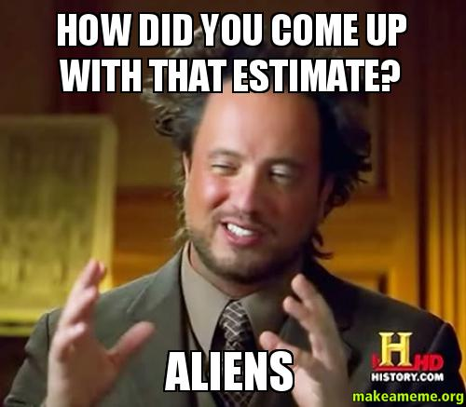
Estimating Square Roots
It is important to be able to estimate the square root of a number. To estimate the square root of a number;
Write out the first few perfect squares.
Find out which two squares the number is between.
Take the square roots of the perfect squares.
Pick a decimal number between the two perfect squares that you believe is close to the answer.

Slide 33
What is √55 when estimating?
Write out the first few perfect squares.
Find out which two squares the number is between.
Take the square roots of the perfect squares.
Pick a decimal number between the two perfect squares that you believe is close to the answer.

Slide 34
What is √76 when estimating?
Write out the first few perfect squares.
Find out which two squares the number is between.
Take the square roots of the perfect squares.
Pick a decimal number between the two perfect squares that you believe is close to the answer.

Slide 35
What is √34 when estimating?
Write out the first few perfect squares.
Find out which two squares the number is between.
Take the square roots of the perfect squares.
Pick a decimal number between the two perfect squares that you believe is close to the answer.

Slide 36
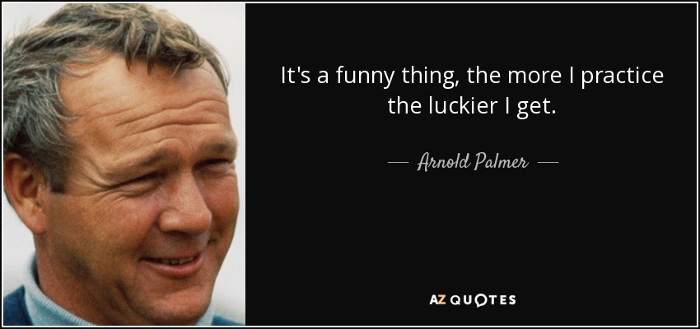
Practice!
Page 18 #1, 2, 4, 5, 13, 14

Slide 37
Review
What is a square root?
What is a perfect square?
c) What makes a square so special?

Slide 38
A fridge magnet has an area of 54 mm². Is 54 a perfect square? If not what perfect square number is closest?

Slide 39
Which of the following numbers are perfect squares? 10, 100, 1000, 10 000, 100 000.

Slide 40
A square floor mat used for gymnastics has a side length of 17m. What is the area of the mat in meters?

Slide 41
The area of a square is 24.0 cm². What is its width?

Slide 42
A square grid contains 400 cells. What is its width?

Slide 43
Mrs. Dewacht told her students’ to run around the perimeter of the school field. The area of the square field is 28 900 m². What distance did the students run?

Slide 44
Practice!
Pages 8-9 Questions #1, 2, 6, 7, 10, 15
Pages 13-14 Questions # 2, 4, 7, 8, 9, 10, 11
Page 23 Questions # 1 - 9

Slide 45
Review
What is the formula for the area of a square?
How do I find the length of a square given the area?
What is a right angle?

Slide 46
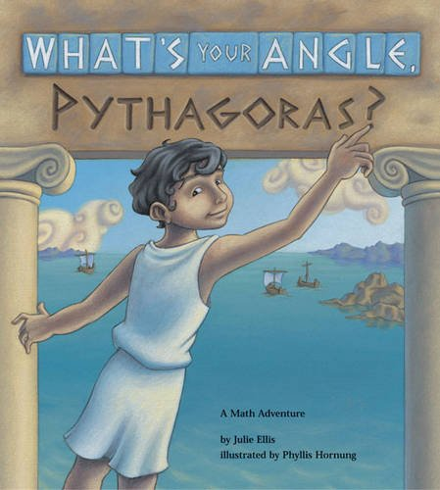
Story Time

Slide 47
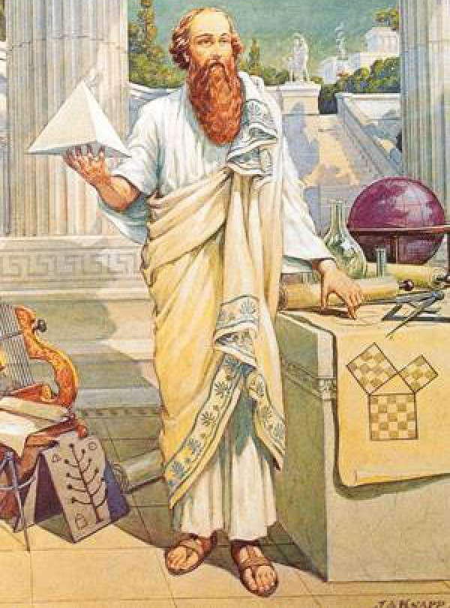
Pythagoras
Pythagoras was a greek philosopher and mathematician. He is credited with proving the theorem for finding the hypotenuse of a right triangle aptly named Pythagorean Theorem.

Slide 48
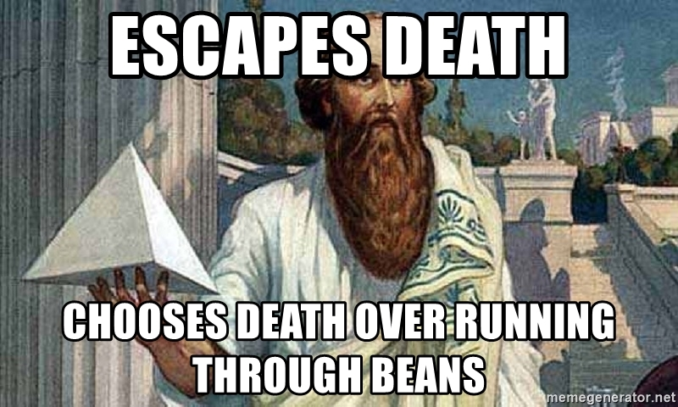
Fun Fact!
Pythagoras had a Brotherhood of mathematicians in Croton. It is there that nobleman named Kylon who was rejected by Pythagoras influenced many local people to create mobs. These mobs went to burn the houses of the Pythagorean Brotherhood.
Pythagoras was among the few lucky ones who escaped the fires. But while trying to escape, the mob that was following him Pythagoras ran out of energy in a bean field. As a life-long vegetarian, he didn’t eat meat but he didn’t eat beans, either, because he considered them our siblings. Pythagoras exclaimed that he would rather die than enter field. The mob then proceeded to stab him to death.

Slide 49
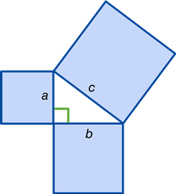
The Pythagorean Theorem
The Pythagorean Theorem states that the sum of the squares on the legs of a right triangle is equal to the square on the hypotenuse.
OR
When a triangle has a right angle and squares are made on each of the three sides, then the biggest square has the exact same area as the other two squares put together!

Slide 50
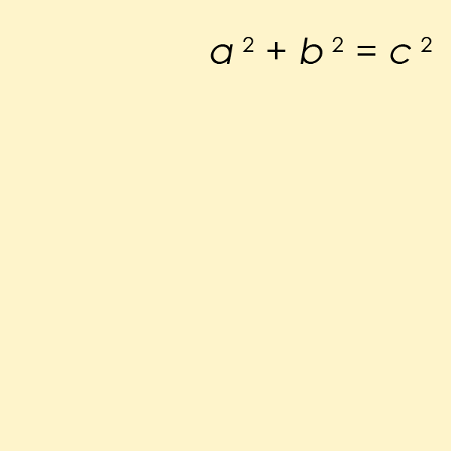
Pythagorean Theorem
The Pythagorean theorem is often written as the algebraic formula;
Where ‘a’ and ‘b’ are the legs of the triangle and ‘c’ is the hypotenuse.
The formula only works with right triangles!
a² + b² = c²

Slide 51
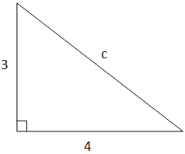
A triangle has legs of 3 units and 4 units. What is the length of the hypotenuse?

Slide 52
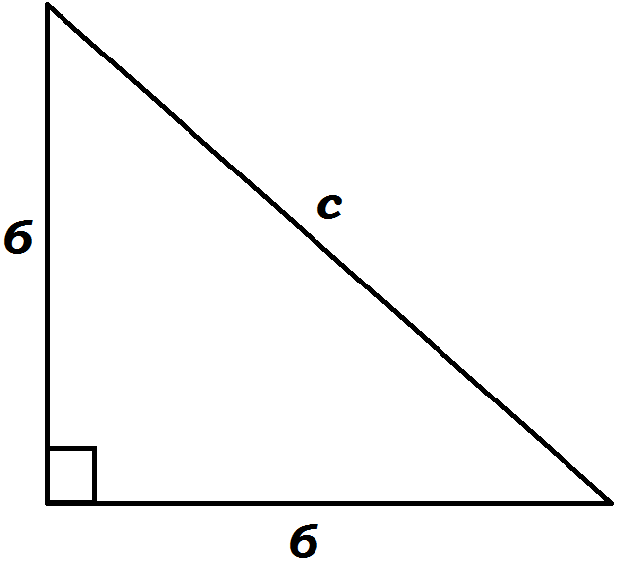
A right isosceles triangle has legs of 6 metres each. What is the length of the hypotenuse to the nearest tenth of a meter?

Slide 53
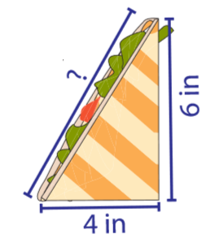
Joey made a sandwich that was 4 inches long and 6 inches high. What is the diagonal length of the sandwich?

Slide 54
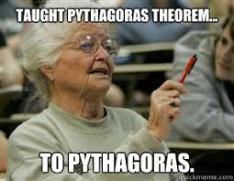
Review
What is a hypotenuse?
What is the Pythagorean Theorem?
What kind of triangles does the Pythagorean Theorem work for?

Slide 55
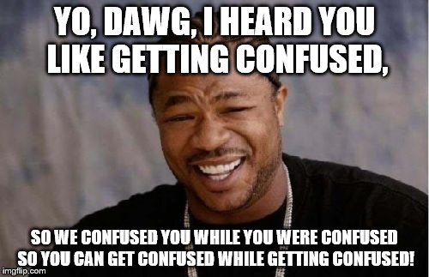
Review
The Pythagorean Theorem is not only used to find the hypotenuse of a right angled triangle. It can also be used to find the legs of the same triangle as long as one of the legs and hypotenuse is known.
Or in other terms you can use the Theorem to find ‘a’ as long as you know ‘b’ and ‘c’.

Slide 56
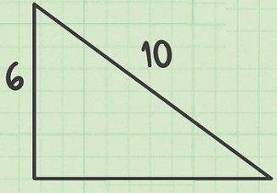
A triangle with hypotenuse of length 10 cm and one leg length of 6 cm is drawn. What is the length of the second leg?

Slide 57
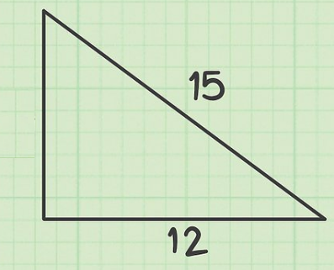
A triangle with hypotenuse of length 15 cm and one leg length of 12 cm is drawn. What is the length of the second leg?

Slide 58
A triangle with hypotenuse of length 13 ft and one leg length of 8 ft is drawn. What is the length of the second leg to the nearest tenth?

Slide 59
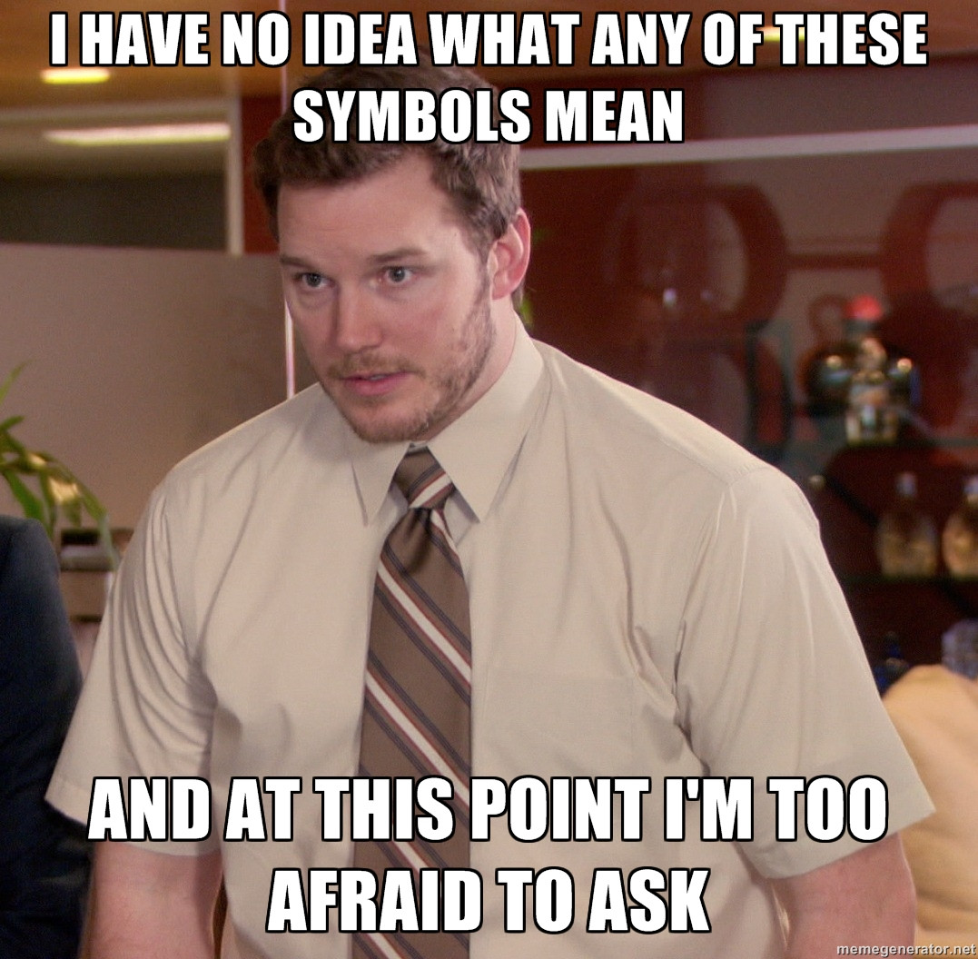
Pythagorean Theorem
One of the best parts of the Pythagorean Theorem is that it works both ways!
This means that if a triangle is a right triangle a² + b² = c², and if a² + b² = c² then the triangle is a right triangle.

Slide 60
A triangle has measures of 8cm, 10cm and 16cm. Is it a right triangle?

Slide 61
Review
What is the Pythagorean Theorem?
What kind of triangles does the Pythagorean Theorem work for?
Can the Theorem also help to find right angle triangles?

Slide 62
The height of a triangle is 4cm and the base of the same triangle is 10 cm. What is the length of the hypotenuse to the nearest tenth?

Slide 63
The hypotenuse of a right triangle is 14.0 cm and the base of the triangle is 8.0 cm. What is the height of the triangle to the nearest hundredth?

Slide 64
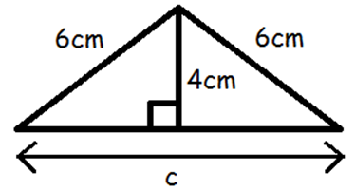
Using the congruent triangles below find the length of side c to the nearest tenth.

Slide 65
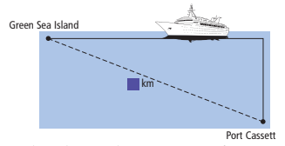
A cruise ship travels from Port Cassett north at a speed of 34 km/h for 2.5 hours. The it turns 90⁰ and travels west at 30 km/h for 7.3 hours. When it reaches Green Sea Island, how far is the ship from Port Cassett. Express your answer to the nearest kilometer.

Slide 66
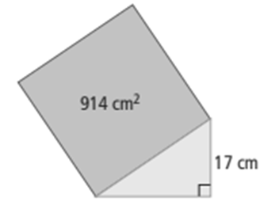
The right triangle below has a square attached to its hypotenuse. What is the perimeter of the triangle? Give your answer to the nearest tenth of a centimeter.

Slide 67
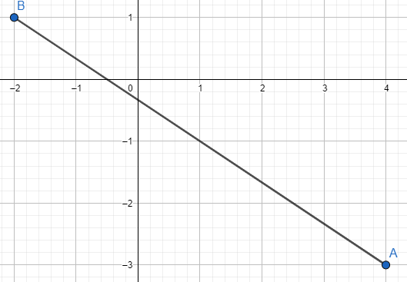
Find the distance between the points (4,-3) and (-2,1).

Slide 68
Mr. Hirsche challenges Mr. Turnbull to a race across the Wilson soccer field measuring 100 yards long and 50 yards wide. Mr. Hirsche runs down the perimeter of the field to the opposite corner, and Mr. Turnbull runs diagonally straight across. Who should win the race?

Slide 69
Practice
Pages 29-31 Questions #1, 2, 5, 7, 9, 10
Page 35 all questions
Chapter Self Test and Chapter Review

