Slide 1
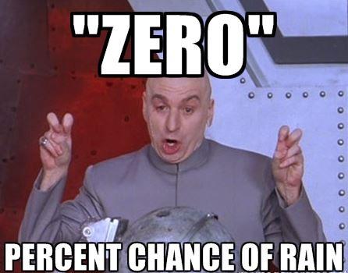
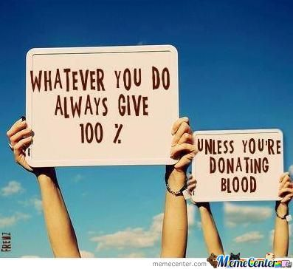
Unit 4
Percents

Slide 2
The history of percent
https://www.youtube.com/watch?v=JeVSmq1Nrpw

Slide 3
Rewrite the following as a fraction and a decimal
79% c) 51%
b) 3% d) 123%

Slide 4
Write the following as fractions in lowest terms
15% b) 4%

Slide 5
Write the following as fractions in lowest terms
c) 45% d) 22%

Slide 6
Convert the following into percentages
0.85 b) 0.54

Slide 7
Convert the following into percentages
c) d)

Slide 8
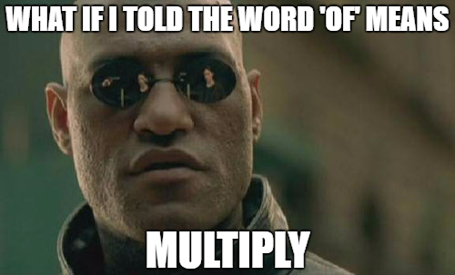
Calculating Exact Percentages
To calculate percentages of numbers;
Change the percentage into a decimal.
If you see the word ‘of’ change it to the multiplication symbol
Multiply the decimal by the number you are calculating the percentage of.

Slide 9
Let’s try!
Calculate 15% of 40.
To calculate percentages of numbers;
Change the percentage into a decimal.
If you see the word ‘of’ change it to the multiplication symbol
Multiply the decimal by the number you are calculating the percentage of.

Slide 10
Examples
What is 12% of 19? b) What is 18% of 29

Slide 11
Word Problem!
Ten co-workers are buying Ted a going away present and will each pay 10%. They decide to buy him a backpack for $92.30 including tax. How much should each person pay?

Slide 12
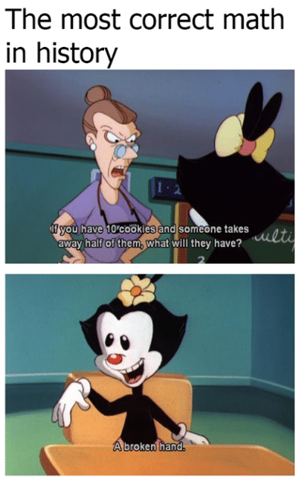
Review!
What does the word ‘of’ mean?
What does the word percent mean?
What is the first step when multiplying by a percent?

Slide 13
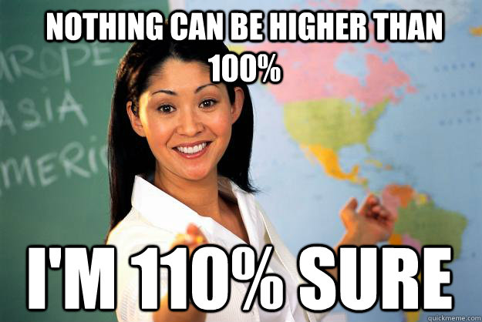
Percents greater than 100
It is possible for percents to represented as greater than 100. For example we can see percents greater than 100 in grades, business earnings and sports.
Percents greater than 100 are still represented as a fraction with 100 as the denominator.

Slide 14
Convert the following percentages into fractions and decimals
157% b) 343%

Slide 15
Convert the following percentages into fractions and decimals
c) 210% d) 101%

Slide 16
Calculate the following
150% of 0.5 b) 120% of 150

Slide 17
Calculate the following
c) 315% of 40 d) 276% of 310

Slide 18
Ivan is 160 cm tall. Tiara is 152 cm tall. Both Ivan and Tiara are 13 years old. An adult's height is normally 107% of his or her height at age 13. What are Ivan and Tiara’s expected adult heights?

Slide 19
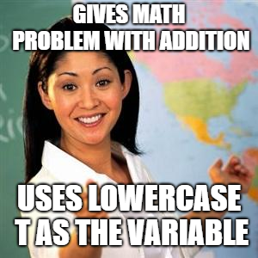
Remember!
In math we are often trying to solve for an unknown variable. A variable is generally represented by the letter ‘x’ or another letter.
Whenever there is an unknown in a question writing a variable can make said question easier to solve.

Slide 20
Solve for the unknown variable
120% of a number is 36 b) 140% of a number is 70

Slide 21
Solve for the unknown variable
320% of a number is 96 b) 205% of a number is 82

Slide 22
A bacon double cheeseburger, fries and a medium milkshake provide a Grade 8 student with 390% of the recommended daily grams of fat allowance. How many grams of fat are in the meal if the recommended daily allowance is 20 grams?

Slide 23
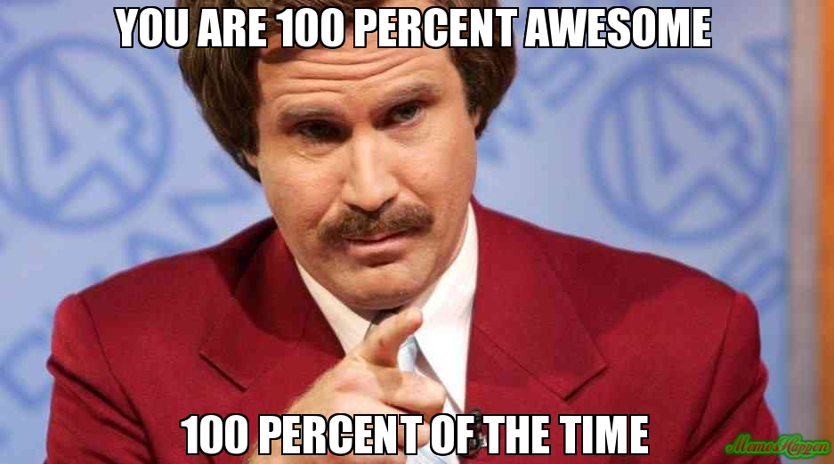
Review!
What does percent mean?
Can percents be greater than 100?
When might we see percents greater than 100?

Slide 24
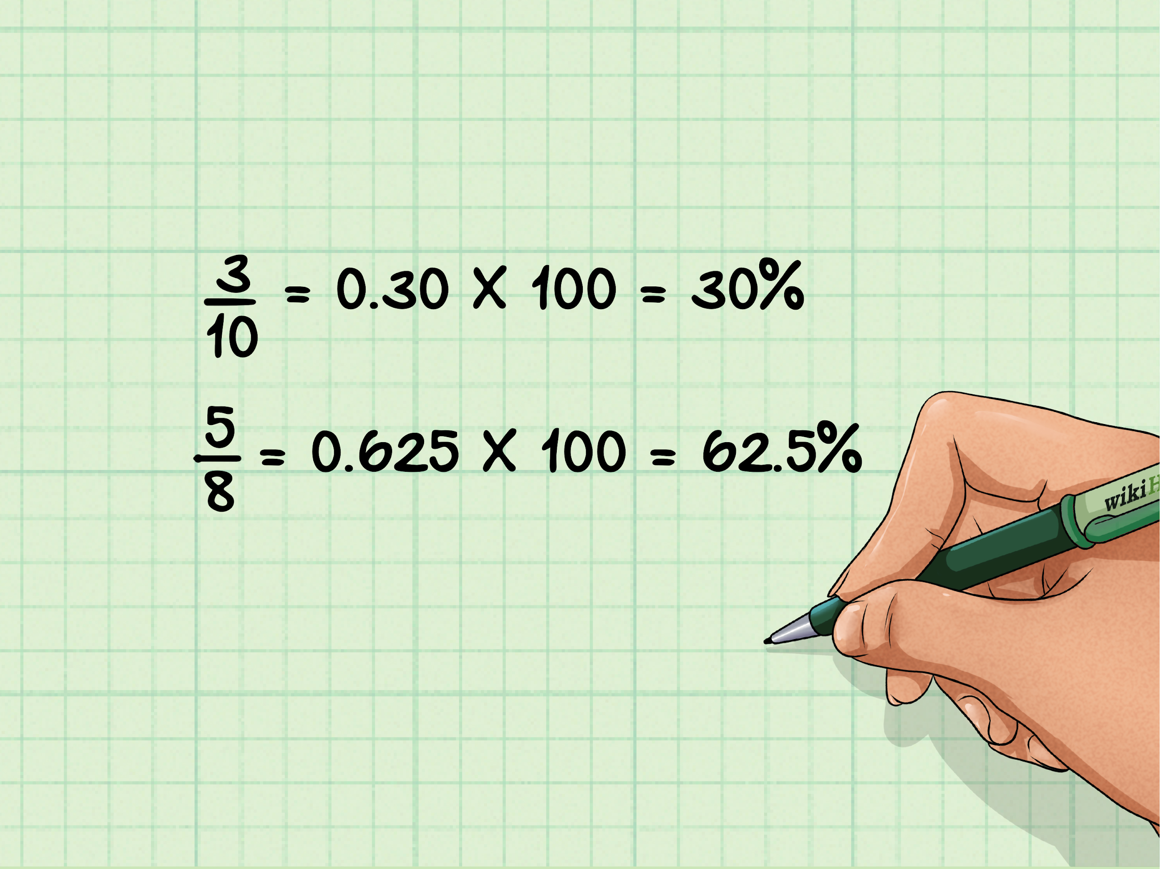
Fractional Percents
A fractional percent is a number out of one hundred that includes a fraction.
Fractional percents can be written as mixed number percents or percentages with decimals.
For example, twelve and a half percent can be represented as 12.5% or as

Slide 25
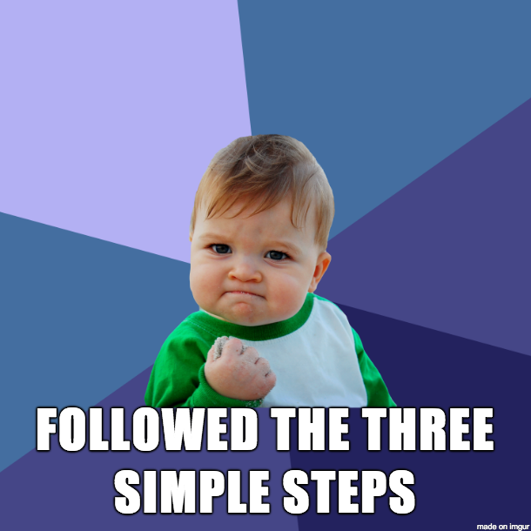
Writing fractional percents as fractions
To write a fractional percent as a fraction;
If included, write the mixed number as a fraction
Divide the fraction by 100
Write the fraction in lowest terms

Slide 26
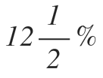
Let’s try!
To write a fractional percent as a fraction;
If included, write the mixed number as a fraction
Divide the fraction by 100
Write the fraction in lowest terms

Slide 27
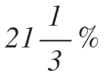
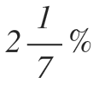
Write the following as fractions in lowest terms
c) d)

Slide 28
Write the following as fractions in lowest terms
c) 25.5% d) 60.25%

Slide 29
Remember!
To calculate percentages of numbers;
Change the percentage into a decimal.
If you see the word ‘of’ change it to the multiplication symbol
Multiply the decimal by the number you are calculating the percentage of.

Slide 30
Calculate
0.5% of 250 b) 1.25% of 320

Slide 31
Calculate
c) 1.5% of 520 b) 3.25% of 410

Slide 32
Your friend wants you to help deliver newspapers that will sell for a total of $350. He gives you two choices. Either 3.5% of total sales or a lump sum of $25. What is the better deal?

Slide 33
Practice!
Pages 152-153 Questions #2, 4, 6, 7, 8
Pages 157-158 Questions # 4, 5, 8, 10, 12
Page 161 Questions #2, 3, 6
Page 165 Questions # 1, 3, 5, 6

Slide 34
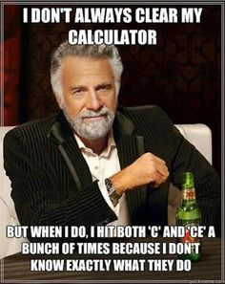
Review!
What does the word percent mean?
How do you write 25.5% as a fraction?
Dow do you write 25.5% as a decimal?

Slide 35
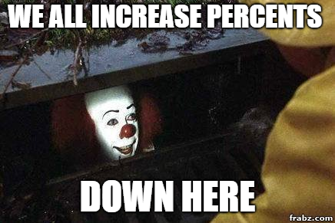
Increasing Percentages
In certain situations a value may be increased by a percentage. When this is the case we add 100% to our original percentage and continue forward.
For example; An increase of 5% is the same as multiplying by 105%.

Slide 36
Calculate the total price
$39.99 with 5% sales tax b) $40.25 with 7% sales tax

Slide 37
Calculate the total price
c) $19.99 with 12% sales tax b) $32.50 with 14% sales tax

Slide 38
In 2005, the number of movie tickets sold in Canada increased 0.5% to 120.3 million. Suppose it increased another 0.5% in 2006.What is the new number of movie tickets sold?

Slide 39
The population of a town with 8500 people increased 8% last year. What is the new population of the town?

Slide 40
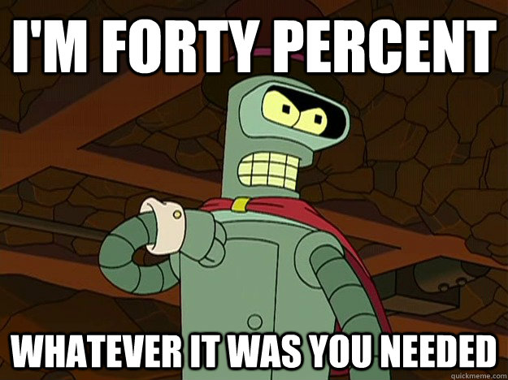
Decreasing Percentages
Percents can also be used to calculate a decrease in number. To calculate a decrease using a percent we subtract from 100% and multiply the number.
For example; A 15% discount is the same as paying 85% of the full price.

Slide 41
Calculate the percent decrease
15% discount on $14.99 b) 32% discount on $18.00

Slide 42
Miriam wants to buy a pair of inline skates. One store is selling the skates at 15% off the regular price of $149.95. Another store is selling the skates for $139.95, with 10% off. Which store has the better price?

Slide 43
Review!
How do you calculate an increase in percent?
What does the word percent mean?
Can you also calculate decreasing percentages?

Slide 44
Calculate
A 30% increase from 50 b) A 150% increase from 50

Slide 45
Mikael’s father bought a new car for $35 500. The car decreased in value by 20% after one year. What was the value of the car after the one year?

Slide 46
John wants to buy an MP3 player. At a store he sees a player that regularly sells for $119.95. It is advertised at 20% off, but, because he lives in British Columbia, he has to pay 5% GST and 7% PST. He has saved $115 from babysitting. Can he buy the MP3 player?

Slide 47
A herd of 200 caribou was moved to a new location. The population increased by 10% the first year and then increased by 20% the second year. What was the percent increase after two years?

Slide 48
A television is on sale for 25% off the regular price of
$339.95. Calculate the discount and the final cost if the tax is 5% in Alberta, where there is no PST.

Slide 49
A student is awarded a $1000 scholarship and places it in an account that pays 3% simple interest per year. What is the total value of the scholarship amount at the end of the second year?

Slide 50
Calculate the missing percent
An increase from 80 to 90 b) An increase from 50 to 200

Slide 51
Calculate the missing percent
c) A decrease from 200 to 100 d) A decrease from 500 to 450

Slide 52
Sam increased the savings in his bank account by 200% when he added a birthday gift from his grandmother. Now he has $330. How much was the gift?

Slide 53
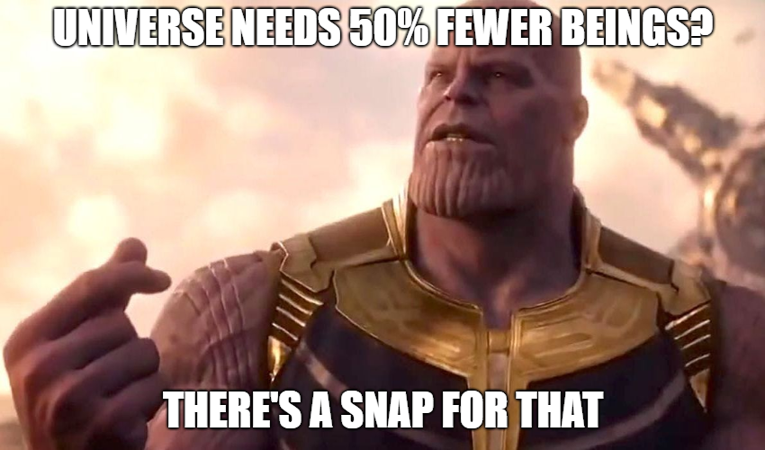
Practice!
Page 173 Questions #3, 4, 5
Page 177 Questions #2, 3, 4, 9
Pages 181-183 Questions #1, 3, 4, 5, 7
Page 186 - Chapter Review

