Slide 1
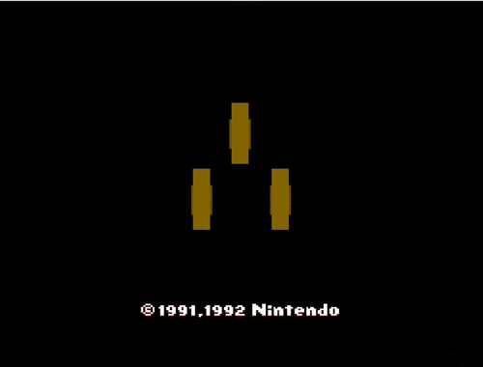
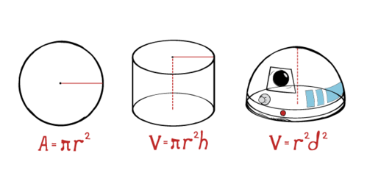
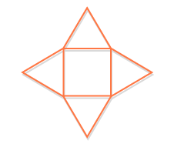
Unit 6
Measurement

Slide 2
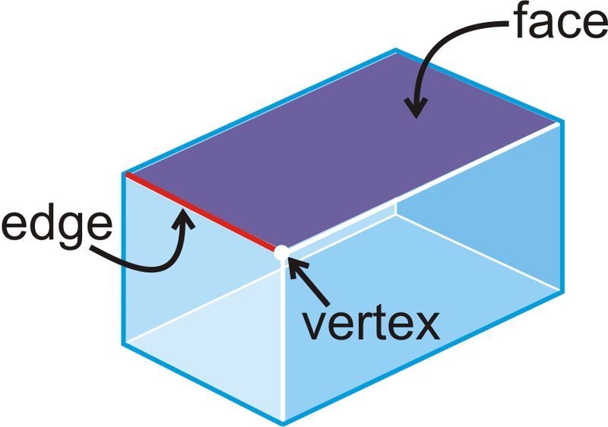
Faces, Vertices and Edges. Oh My!
When examining a 3D shape it is important to be able to identify the number of faces, vertices, and edges.
A face is any flat surface on the shape. Faces are usually polygons.
A vertex is a corner of the shape. Vertices are joined by edges.
Edges are found on any line where two faces meet.

Slide 3
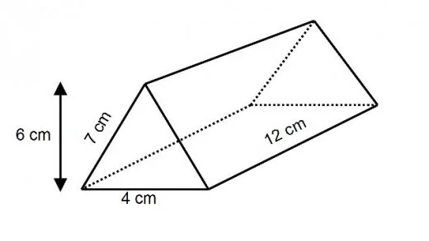
How many edges, vertices and faces?

Slide 4
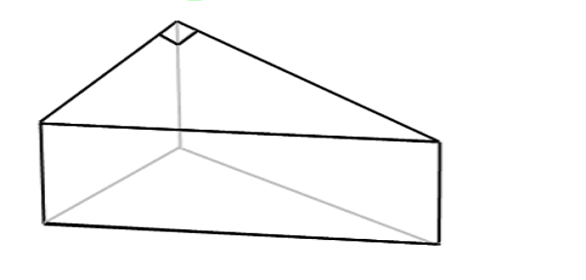
How many edges, vertices and faces?

Slide 5
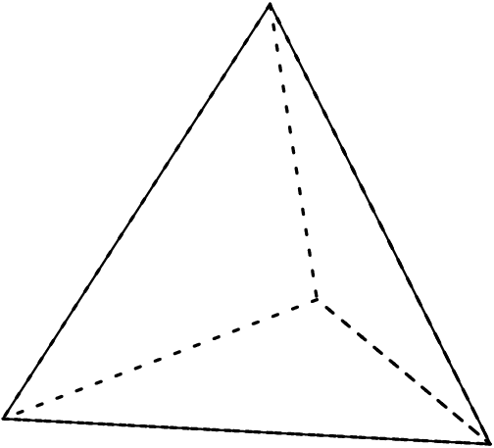
How many edges, vertices and faces?

Slide 6
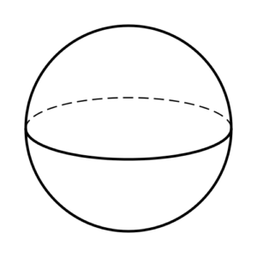
How many edges, vertices and faces?

Slide 7
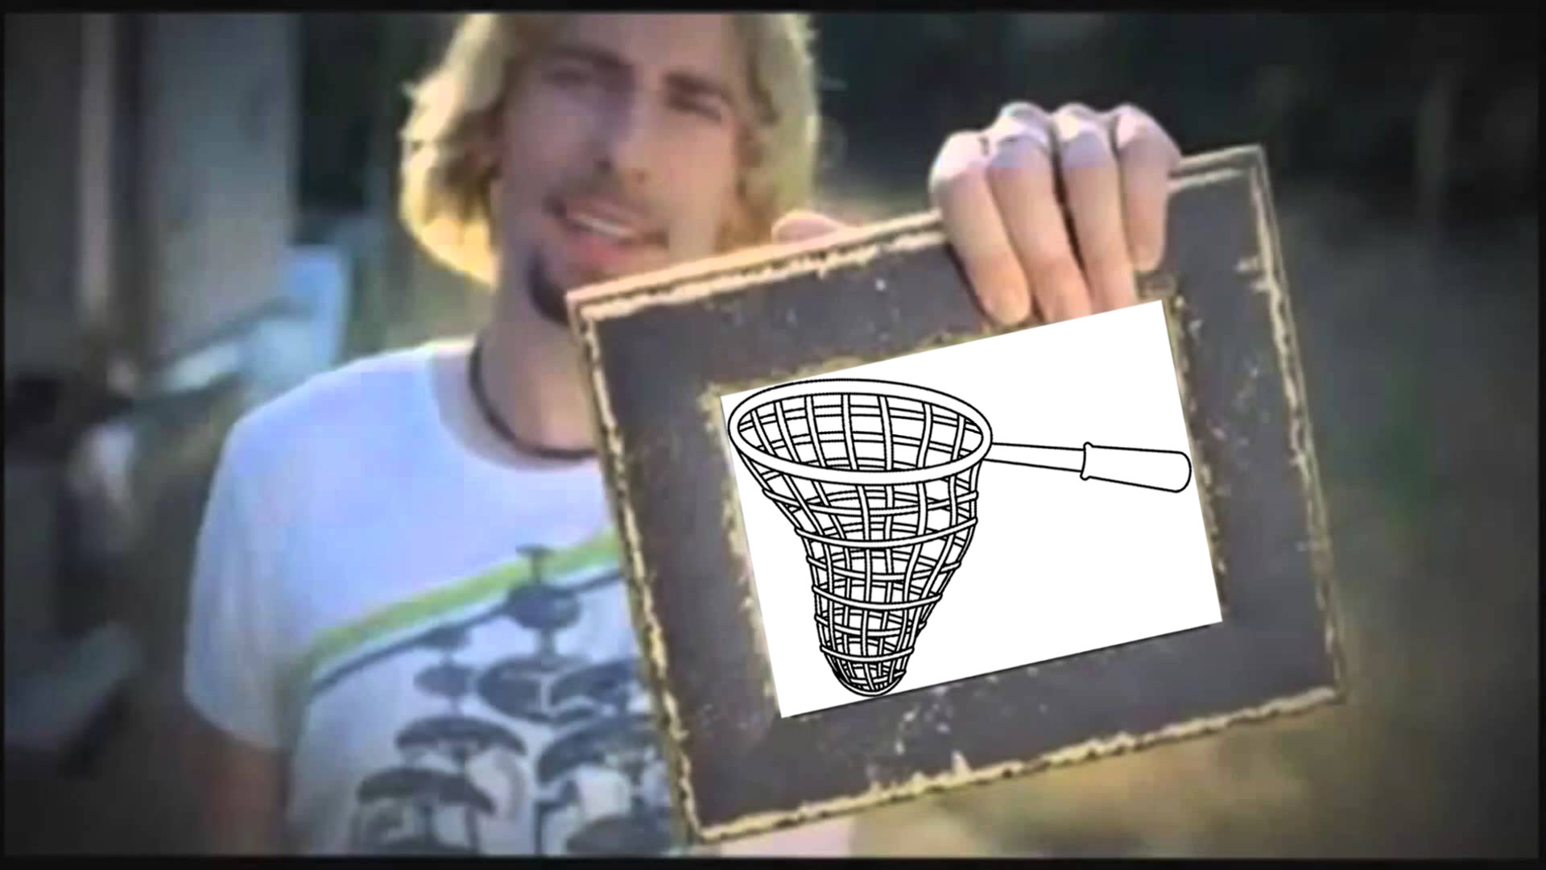
Nets
A net is a 2D pattern that you can cut and fold to make a 3D model of a solid shape.
Nets can be made of all kinds of polygons. However, true nets do not contain extra parts to assist with folding.

Slide 8
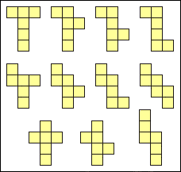
Nets
Nets can look different and still make the same shape. For example there are 11 different nets for a cube.
Nets must however contain the same measurements, vertices, edges and number of faces to be congruent.

Slide 9
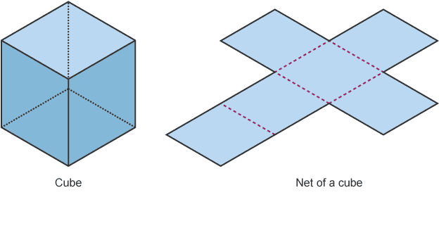
A cube and net

Slide 10
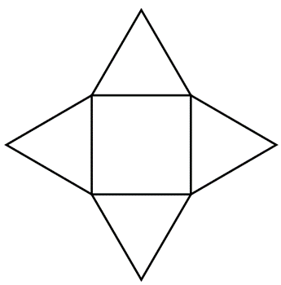
Square base pyramid net

Slide 11
Build your own
From the nets available, build the shape it creates.
What shapes does your net contain?
Can you guess what shape it will create before building?
How many edges, vertices and faces does your shape have?

Slide 12
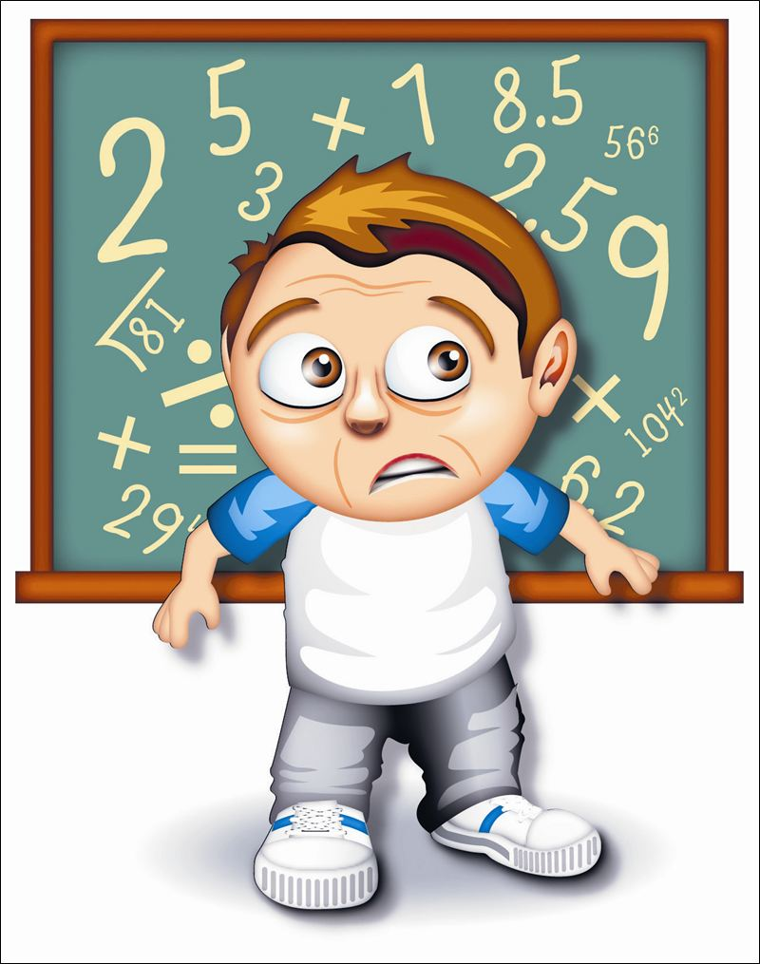
Review
What is a net?
What are vertices, faces and edges?
Are the measurements of a net the same as the shape?

Slide 13
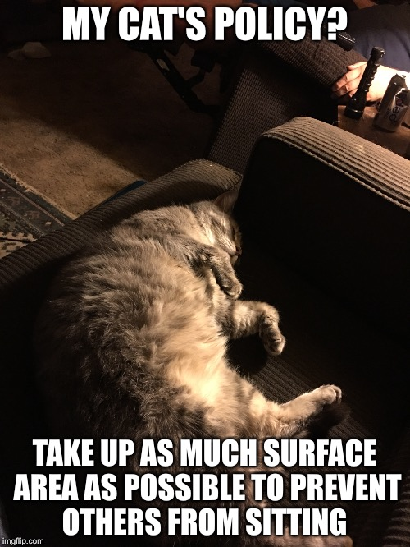
Surface Area
The surface area of a shape is the total area of the surface of a three-dimensional object.
To find the surface area of a shape, simply find the areas of all faces and add them together.

Slide 14
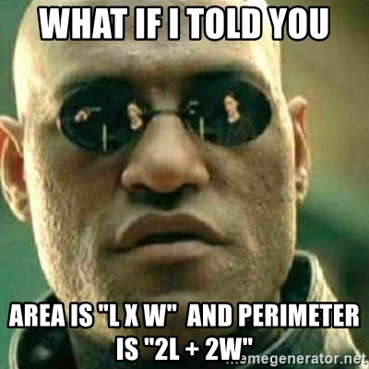
Remember!
The areas of both rectangles and squares can be found by multiplying the base and height. That is;
A = base x height

Slide 15
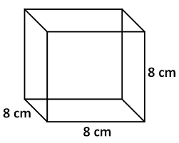
What is the surface area of the cube?

Slide 16
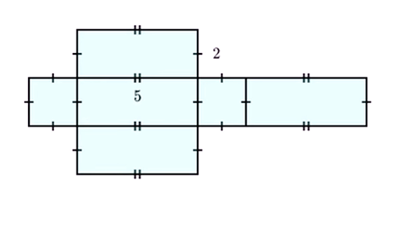
What is the surface area of the prism?

Slide 17
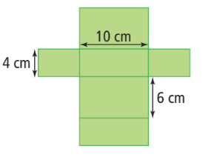
What is the surface area of the prism below?

Slide 18
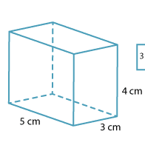
What is the surface area of the prism below?

Slide 19
Keiko has two gift boxes that each measure
8” x 9” x 2”. How much wrapping paper does she need to cover the two boxes?

Slide 20
Review
What is surface area?
How do you find surface area?
How do you find the area of a triangle?

Slide 21
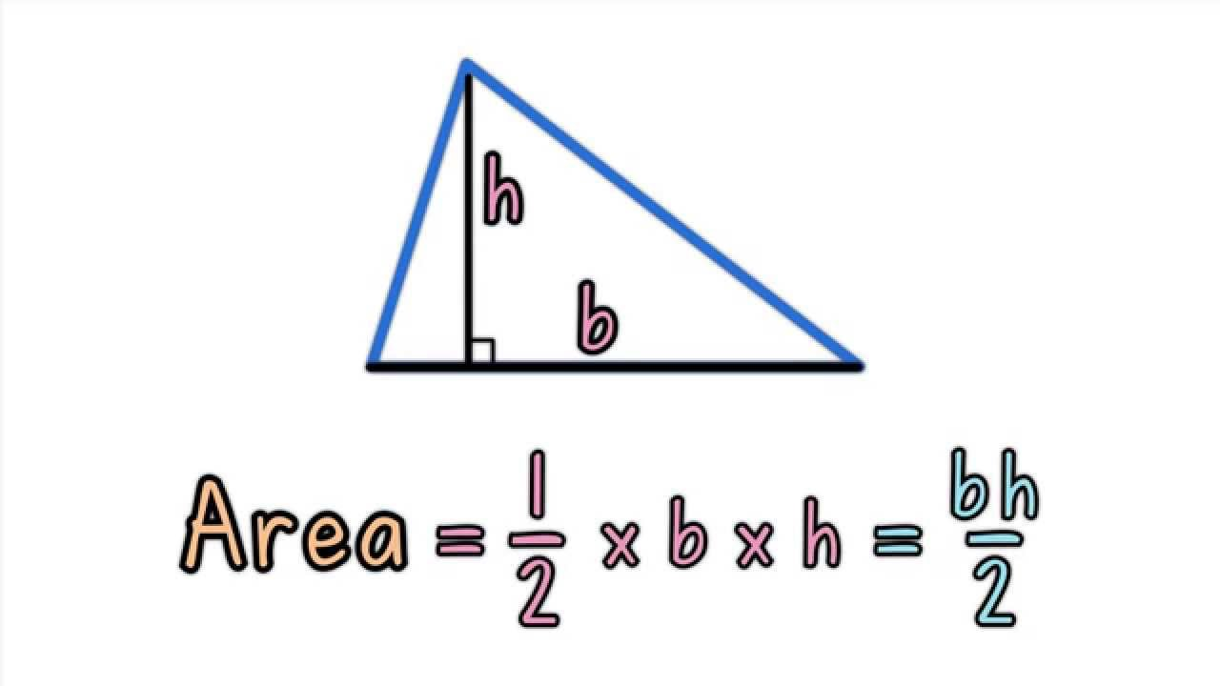
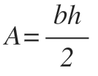
Remember!
The area of a triangle can be found by multiplying the base and height and dividing by 2. That is;

Slide 22
What is the surface area of the triangular pyramid?

Slide 23
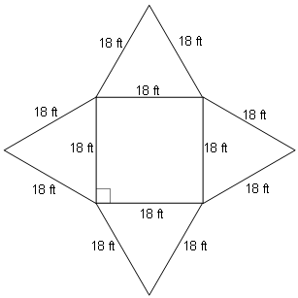
Surface area and distractors
There are many different measurements possible for objects and the shapes that create them.
When finding surface area it is important to be aware of which measurements are important. It is sometimes helpful to visualize the net of the object to do so.

Slide 24
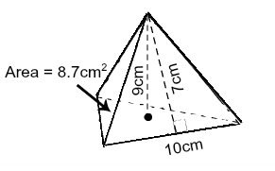
What is the surface area of the triangular pyramid?

Slide 25
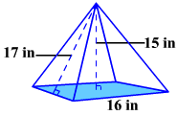
What is the surface area of the square pyramid?

Slide 26
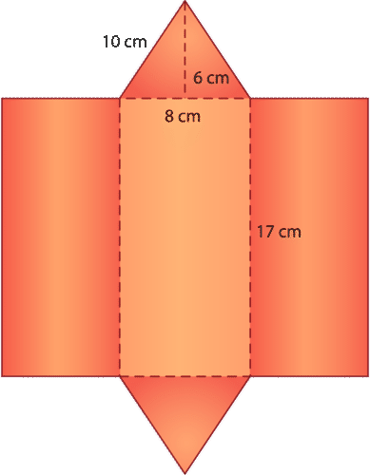
What is the surface area of the triangular prism?

Slide 27
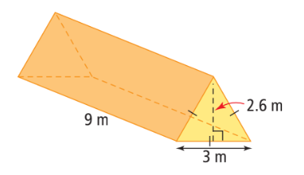
What is the surface area of the triangular prism?

Slide 28
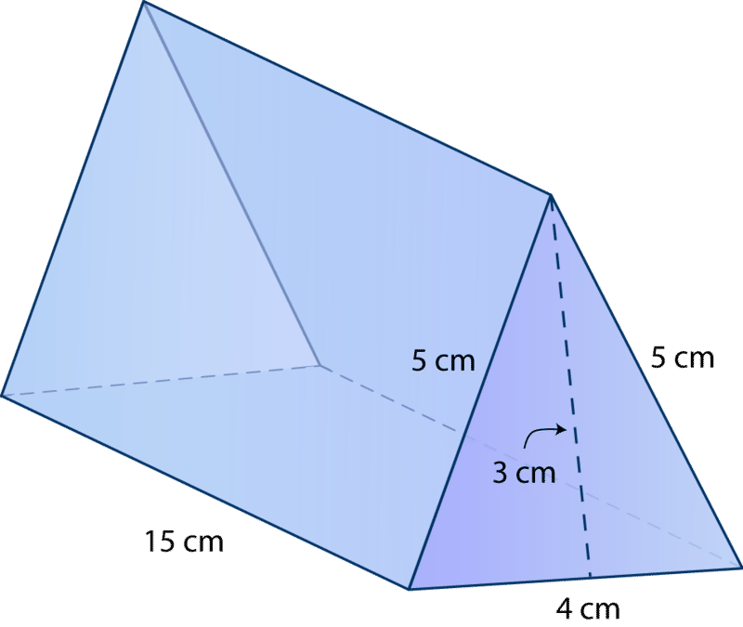
What is the surface area of the triangular prism?

Slide 29
Review
How do you find surface area?
What is a distractor?
What is the Pythagorean Theorem?

Slide 30
A square cake pan measures 30 cm on each side and is 5 cm deep. Cody wants to coat the inside of the pan with non-stick oil. If a single can of non-stick oil covers an area of 400,000 cm², how many pans can be coated with a single can?

Slide 31
Ethan is hosting games night this weekend. He bought ten packages of playing cards. Each package measures 9 cm × 6.5 cm × 1.7 cm. He wants to build a container to hold all ten packages of cards. What are the minimum dimensions of the container?

Slide 32
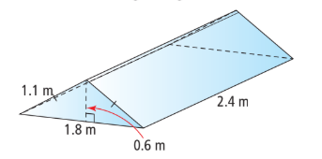
Robert wants to build a glass greenhouse. The greenhouse will have all glass sides and no bottom. The greenhouse dimensions are shown below, how much glass will Robert need to build the greenhouse?

Slide 33
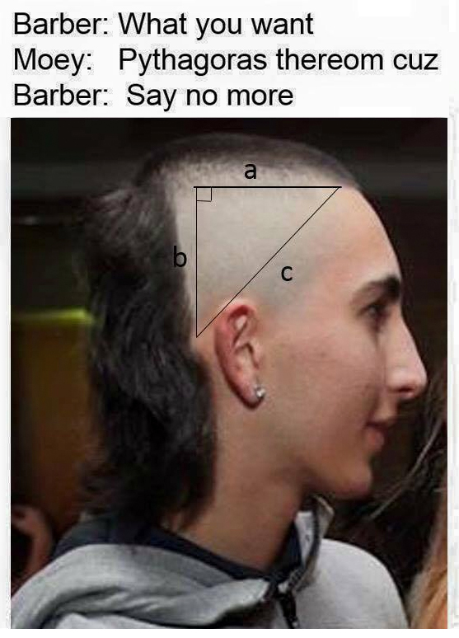
Remember!
The Pythagorean Theorem can be used to find the sides of a right triangle. The theorem states that the square of the hypotenuse of a right triangle is equal to the sum of the square of the other two sides. Or more simply;
a² + b² = c²

Slide 34
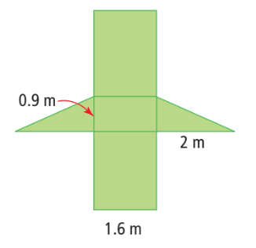
Jay wants to make a bike ramp. He draws the following sketch. What is the surface area of the ramp?

Slide 35
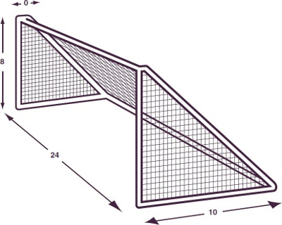
How much netting is needed for the soccer net?

Slide 36
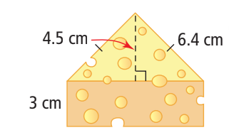
Cheese is sometimes packaged in a triangular box. How much cardboard would you need to cover this piece of cheese if you do not include overlapping?

Slide 37
Review
How do you find surface area?
What is the difference between radius and diameter?
What shapes make up a cylinder?

Slide 38
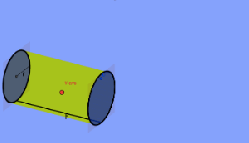
Cylinders
A cylinder is a three-dimensional shape that is round with the top and bottom in the shape of a circle.
The two circles of a regular cylinder are always the same dimension. It can be hard to picture, but unrolled a cylinder contains two circles and one rectangle.

Slide 39
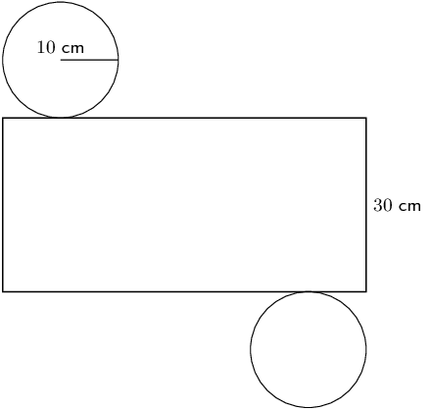
Cylinders
Because of the shapes in the net of a cylinder we can calculate the surface area by finding the area of the rectangle, and areas of the two circles.
Unfortunately to find the length of the rectangle we often need to find the circumference of the circles.

Slide 40
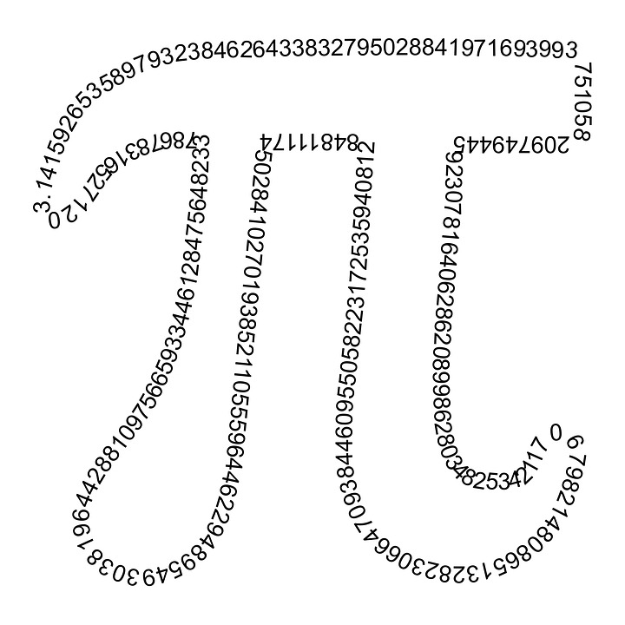
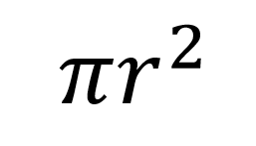
Remember!
Two important formulas for circles are;
Area =
And
Circumference =

Slide 41
Cylinders
To find the surface area of a cylinder we;
Find the area of the circles
Find the circumference of the circles
Using the circumference of the circles, find the area of the rectangle

Slide 42
Find the surface area of the cylinder

Slide 43
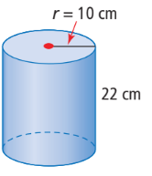
Find the surface area of the cylinder

Slide 44
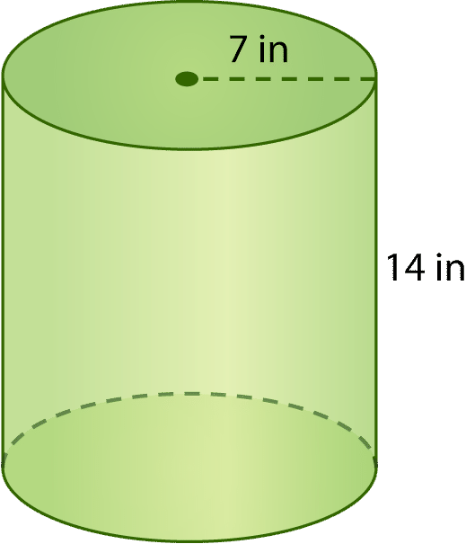
Find the surface area of the cylinder

Slide 45
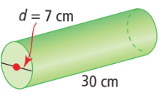
Find the surface area of the cylinder

Slide 46
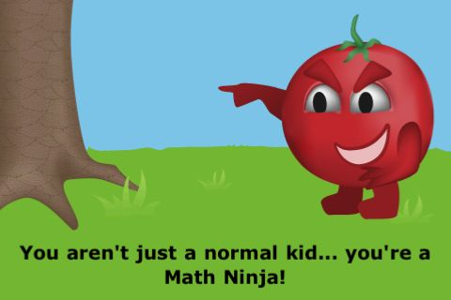
Review
What shapes make up a cylinder?
What are the formulas for circumference and area?
What is the difference between area and circumference?

Slide 47
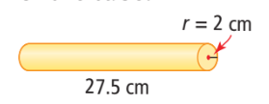
Paper towel is rolled around a cardboard tube. Calculate the outside surface area of the tube.

Slide 48
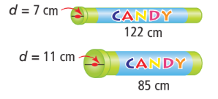
Kaitlyn and Hakim each bought a tube of candy. Both containers cost the same amount. Which container required more plastic to make?

Slide 49
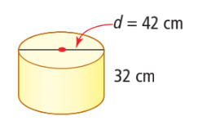
Anne wants to re-cover the cylindrical stool in her bedroom. How much material does she need if there is no overlap and she does not cover the bottom of the stool?

Slide 50
A can of frozen juice that is 6.7 cm in diameter and 11.8 cm
high is made of a cardboard tube, and a metal top and metal
bottom. Suppose 24 cans are recycled. How much cardboard is recycled?

Slide 51
Coins can be stored in a plastic wrapper similar to a cylinder. A roll of dimes contains 50 coins. Each dime has a diameter of 17.5 mm and a thickness of 1 mm. Calculate the minimum surface area of the plastic wrapper.

Slide 52
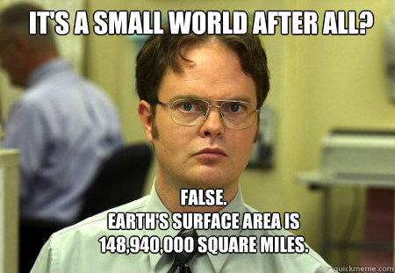
Practice!
Pages 198-199 Questions # 2, 4, 8
Page 206 Questions # 6, 7, 8, 11a
Pages 212-213 Questions # 1, 2, 4, 5, 10
Pages 216 Questions # 2, 3, 5, 6

Slide 53
Review
What is surface area?
What is a net?
What does it mean to have a measurement like cm³?

Slide 54
Volume
Volume is the measure of the amount of space inside of a solid figure, like a cube, ball, cylinder or pyramid.
It's units are always "cubic", and can often be found by multiplying the area of the base by the height.

Slide 55
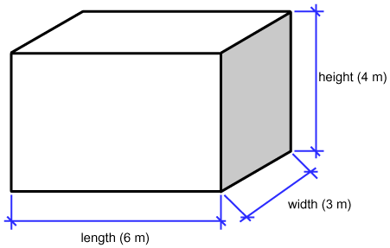
Rectangular Prism Volume
The volume of a rectangular prism or a cube can be found by finding the area of the base and multiplying by the height of the cube. That is;
Area = length x width x height

Slide 56
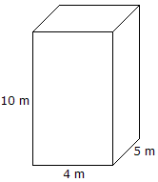
Find the volume

Slide 57
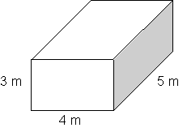
Find the volume

Slide 58
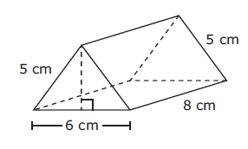
Volume of a triangular prism
The volume of a triangular can be found by finding the area of the base and multiplying by the height.
In the case of a triangular prism the base is considered to be the triangle, and the height is the distance between.
That is;
Area =

Slide 59
Find the Volume

Slide 60
Find the Volume

Slide 61
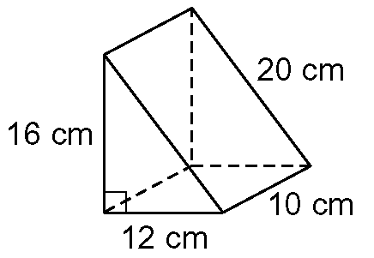
Find the Volume

Slide 62
Which backpack holds the most?

Slide 63
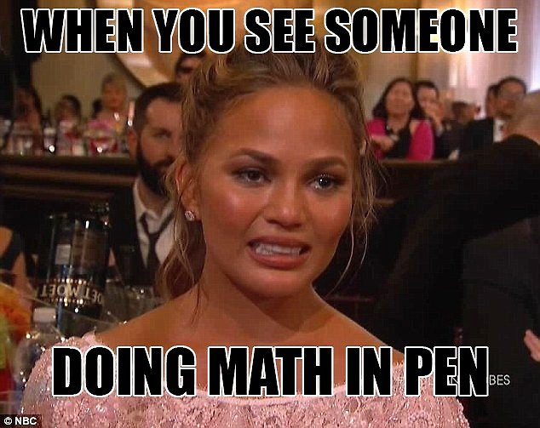
Review!
What shapes make up a cylinder?
What is the difference between surface area and volume?
How do you find most volumes?

Slide 64
Volume of a cylinder
The volume of a cylinder can be found by finding the area of the base and multiplying by the height.
In this case the base is a circle so it is important to remember the formula for area of a circle;
A =

Slide 65
Find the volume

Slide 66
Find the volume

Slide 67
Find the volume

Slide 68
Find the volume

Slide 69
Which container holds more?

Slide 70
Practice!
Page 220 Questions #1, 3, 5, 9, 13
Page 225 Questions #1, 2, 3, 9
Pages 233-234 All questions
Pages 238 All questions

